Slide 1
Lunch and Learn
Fix the culture not the women

Slide 2
Poll
Who believes a job should be given on capability and not gender
Agree
Disagree
Neither
Don’t know

Slide 3
Uncovering the UNLEVEL playing field.
Karen and I had successful corporate careers and in the main very enjoyable. It wasn’t until we became involved in supporting organisations to improve their performance by improving their gender-balance, that we started to realise that lots of things needed to change, and that did not include the women!
What we found made us realise too, just how much we had gone along with an unlevel playing field and often not noticed or been aware of what was happening.
Even organisations with great employee satisfaction, with people awards and accreditations and employees who think they are getting it right are operating on an UNLEVEL playing field

Slide 4
Quiz – unconscious bias …
Which of the following are gender-biased behaviours?
Asking a woman to tidy up because they are so much better at it than the men
Asking a woman to go and find out why someone in the team is clearly upset about something that happened in the meeting
Arranging the next sales conference on the golf course
Writing this in a performance review “You are very well liked in the team but you don’t have ‘executive presence’.
Insisting the candidate would need to be in the office before 9 every day
Succession planning meeting that decides on the promotion based on perceived family responsibilities
Saying “I don’t think she is right, she doesn’t look convincing.”
Being given a smaller portion of chips in the staff restaurant
How many biases are happening in your organisation/department?
Y/N

Slide 5
Unlevel playing fields
66% of women’s performance reviews contain at least one negative comment about their personality “You come across as a bit abrasive ..” Compared to 1% of men.
It’s entirely optional for men to ‘get along with others’ It’s absolutely necessary for women
Women are judged on Performance Men are judged on Potential!! Women receive significantly LOWER ‘Potential’ ratings despite HIGHER ‘Job Performance’
AMBITIOUS is NOT a compliment for women – NICENESS is a requirement
Performance reviews

Slide 6
Unlevel playing fields
Break Bias by removing names at initial screening
Women frequently offered less salary.
Mum’s are 79% less likely to be hired than non-mother candidates because they are: “less competent and less committed”
Recruiting
and
Promoting

Slide 7
Unlevel playing fields
Women are too busy doing their job and the Office housework
Women either lack experience or the right qualification
Recruiters justify hiring a man for ‘better qualifications’ until he has ‘more experience’, at which point they rank experience as “essential.”
If a women has more experience, the recruiters still chose the man because “education is key”.
And a man has more potential even though he hasn’t necessarily proven it!
TYPE 1
Career Enhancing
High Profile
Ordering lunch | Scheduling meetings
Taking Notes | Clearing Up
Emotional repairing | Diversity work
Projects
TYPE 2
Organisation Enhancing
Low Profile
Women are good for these projects

Slide 8
Unlevel playing fields
Men interrupt and talk over women at an alarming rate.
Boys aged 3½ – 5 years old interrupt girls twice as often as the other way around!
Parents interrupt daughters more than their sons!
Men talk more than women, at work, 47000 words per day v 16000
Men talk for longer - the longest comment by a woman was shorter than the shortest comment by a man! Have you ever heard a man ask “Sorry, have I talked too much?”
Men feel entitled to take the space and be listened to v Women who feel embarrassed so hedge “Do you think…”
Men blatantly steal women’s ideas and present them as their own so Women devise strategies e.g. ‘Amplification Strategy’
Women, it seems, are not as interesting or worthwhile to listen to as Men, who withdraw often showing irritation and impatience.
Next time you’re in a meeting count the times a man looks at his watch, papers, phone
Men regularly and blatantly steal women’s ideas, did you know in the Obama White House women in his cabinet formed an ‘Amplification Strategy’. When a woman made a key point, other women would repeat it, giving credit to its author, forcing the men to accept the contribution
Men talk a LOT more than women, yes it’s true! At work men got the top spot for 47000 words a day v average of 16000.
Men are given the ‘entitlement’ to take the space to speak and be listened to – many women feel embarrassed when they do!
Men are clearly more interesting! When a woman take the space men are often seen to withdraw, look at papers, the time and shift around. Showing no active attention or listening to their peer women
Meetings

Slide 9
Group activity
What ‘unlevel playing field’ practices do you see happening to women in transport?
Talent
Opportunities
Performance reviews
Meetings
Projects
HR Practices
Unconscious bias
Promotions
Recruitment
Flexible working

Slide 10
Poll - How do Women fare in the Transport Industry?
What percentage of women in transport feel they have to adapt their personality to get by in the industry?
0-25%
25-50%
50-75%
75% and above

Slide 11
Result – 58%

Slide 12
Poll
What percentage of women in transport feel they have experienced discriminatory behaviour from their colleagues?
0-25%
25-50%
50-75%
75% and above

Slide 13
Result

Slide 14
The not so level playing field for Women in Transport

Slide 15
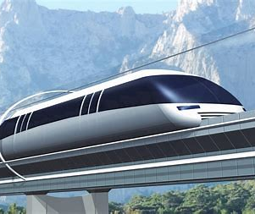
The Future of Transport
Transport serves everyone, To bring a truly dynamic range of views to successfully shape its future, requires a diverse workforce.
Women still make up only 20 per cent of this workforce (European Commission, 2017).
Reasons include:
‘Entrenched gender bias in cultural patterns and behaviours.’ (Bicquelet Lock et al 2020)
‘Men and their priorities still dominate the bulk of transport policymaking.’ (Cresswell and Uteng, 2016)
‘The archaic belief that transport is not for women’ (Field and Hullard 2021)

Slide 16
Group Activity - What can you do in your role to level the playing field for Women in Transport?
Depending on your role please explore what actions you will take to level the playing field for women in your area of transport.
Are you …
A member of a Senior Management team
A Manager, Team Leader
An HR colleague
Any other role

Slide 17
There is no point in trying to fix the women!
We have to FIX THE CULTURE! … But HOW?
Change takes a compelling ‘Why’, a strong vision and leadership, clear and continuous communication.
Here are 5 steps to get you started…
Understand where your gender-balance issues are – get some metrics!
Gain your senior managers' commitment, talking the talk AND walking the walk.
Get the men in your organisation on board.
Test for and challenge unconscious biases, in men and women
Influence your HR team to review your people policies and practices

Slide 18
Tips for better gender-balance
Individual
Proactive conversations – career, support, work/life balance
Networks/Women in business groups
Leader
Check for bias in performance, talent, recruitment etc.
Role model – share your story
Organisation
Diagnostics and Metrics at every level
Exec Gender related goals
Champion flexible work practices
Find a sponsor
Change outdated practices

Slide 19
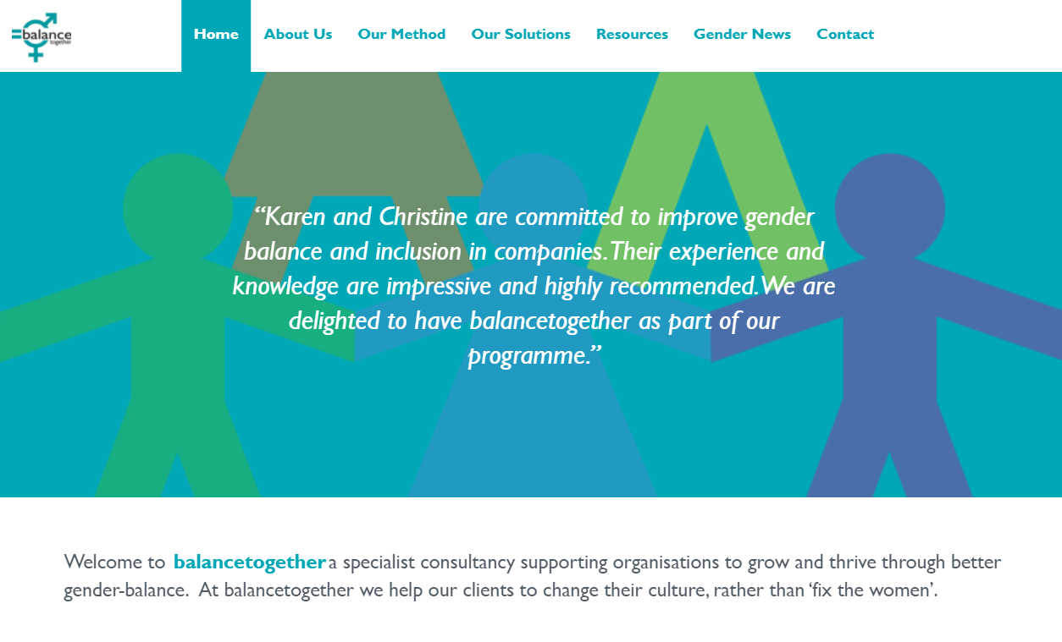
We’d love to hear about your progress and ideas to promote women in the workplace.
Please link in with us
Karen Milner | LinkedIn
karen@balancetogether.co.uk
Christine Gilkes | LinkedIn
christine@balancetogether.co.uk
www.balancetogether.co.uk

